Slide 1
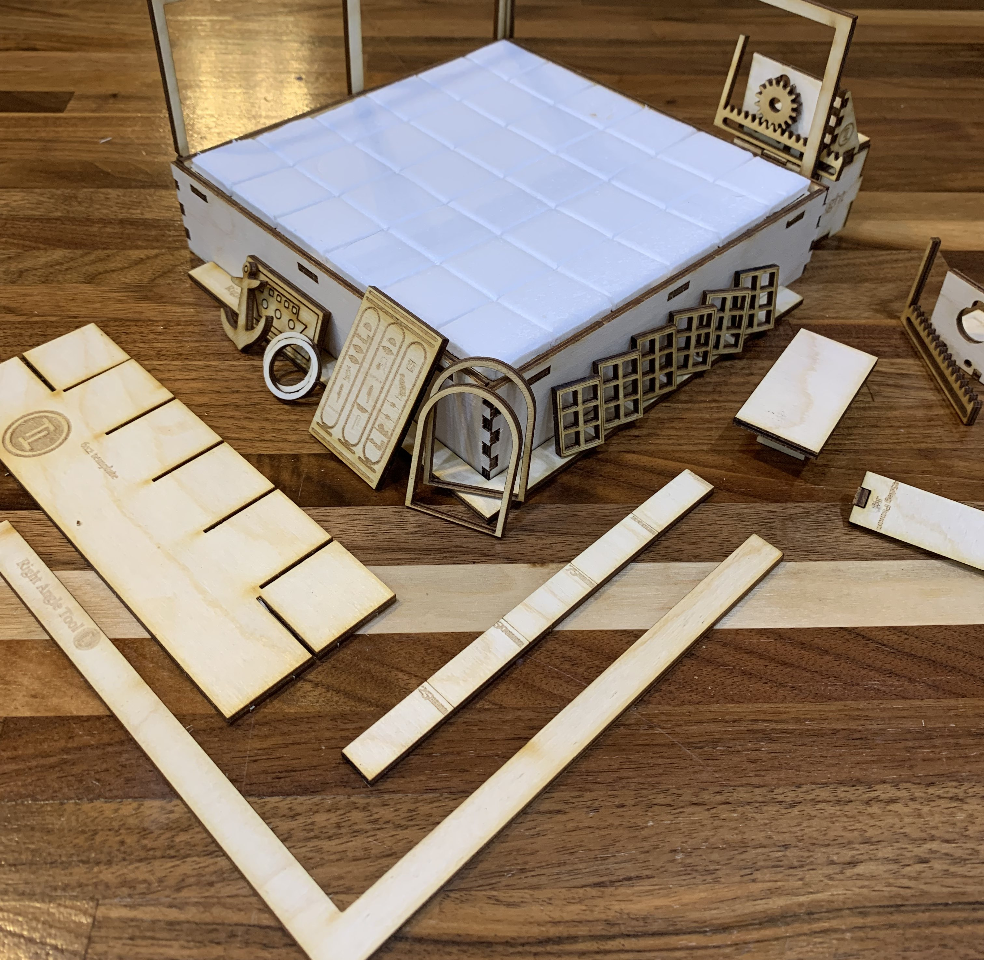
6x6 Puzzle Room Kit
Builders Guide 1/16/2022

Slide 2
Designers Advice
The main parts of this kit are the 6x6 puzzle room walls and base. Other parts on the 12”x12” sheet are complimentary, and assembly is left as an exercise for the customer! ☺ May the odds always be in your favour!
The 6x2 Jig and Right angle tool are useful ones to keep in your toolbox. There’s also a 45 Degree jig for a proxon too!
For wooden part assembly, use PVA/Wood Glue/Eileens Tacky Glue
Use a small file to sand parts that are a little reluctant to fit. Wood isn’t the most stable of materials! ☺
When gluing, consider using a little hot glue along with your wood glue. The hot glue will hold items in place whilst the wood glue dries. Long term strength will come from the wood glue.
Superglue / CA glue is AWFUL with wood.
Please contact me on Instagram or facebook with feedback! (I’ll give you the right email address etc there… just to avoid spam!)

Slide 3
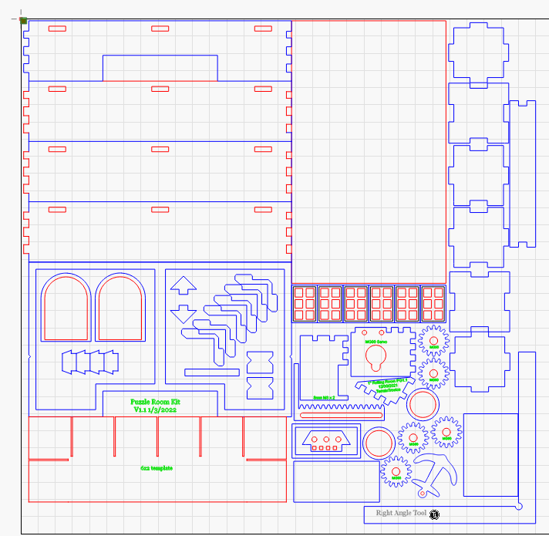
Wooden Parts
1 – 4 sides to puzzle room
2 – Solid Wall to puzzle room. (can be used as a template)
3 – 35mm square box – same height as puzzle room frame. Useful for mounting motors for doors etc.
4 – Framed wall for puzzle room, has cuttout for electronics to pass through too.
5 – Door frames
6 – Brackets for the puzzle room sides
7 – Table Parts
8 – 2x6 template tool
9 – 45 degree post jig for a proxxon
A – Door (attach to motor etc)
B – Mechanics to open a door/trap etc.
C – Decorations for puzzle rooms.
D – Window Frames
1
3
2
1
3
1
3
9
1
3
4
6
5
5
9
6
D
3
6
B
6
B
B
3
7
B
C
C
C
B
B
C
A
8
7

Slide 4
Extra Parts In the Kit
2x 6x6 Pre-Scored Foamboard floors
You can texture for stone or wood, then modpodge and paint away.
8x Reed Switch PCB’s
Requires Assembly with Reed switches.
8x Reed Switches
1x Conwy Board
Good old Conwy.
4x Flickering LED’s.
Ideal for running with Conwy boards.
8x 18mm Magnets to hold walls on.

Slide 5
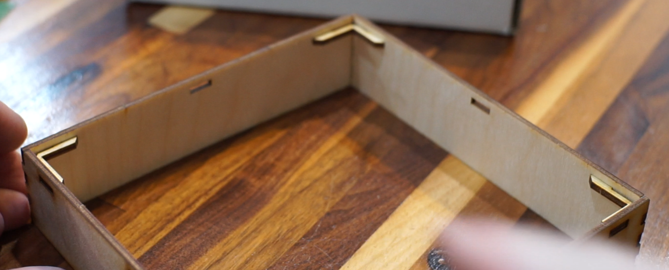
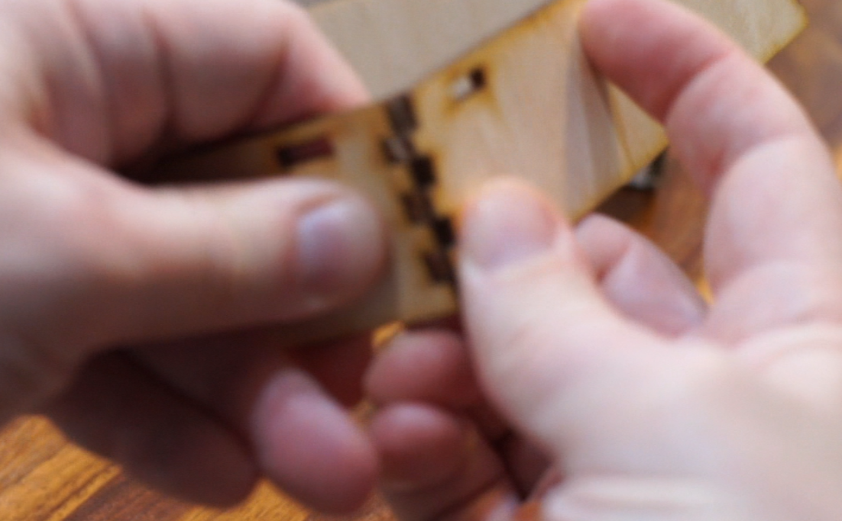
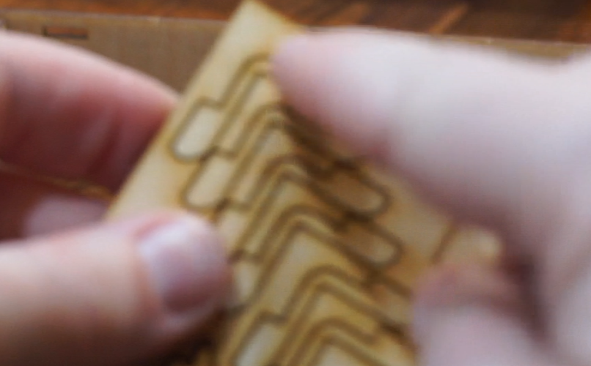
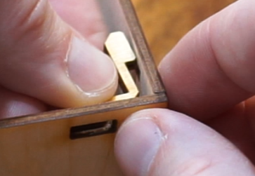
Basic Assembly
4 sides click into each other.
Insert Braces into corners.
They can only go one way.

Slide 6
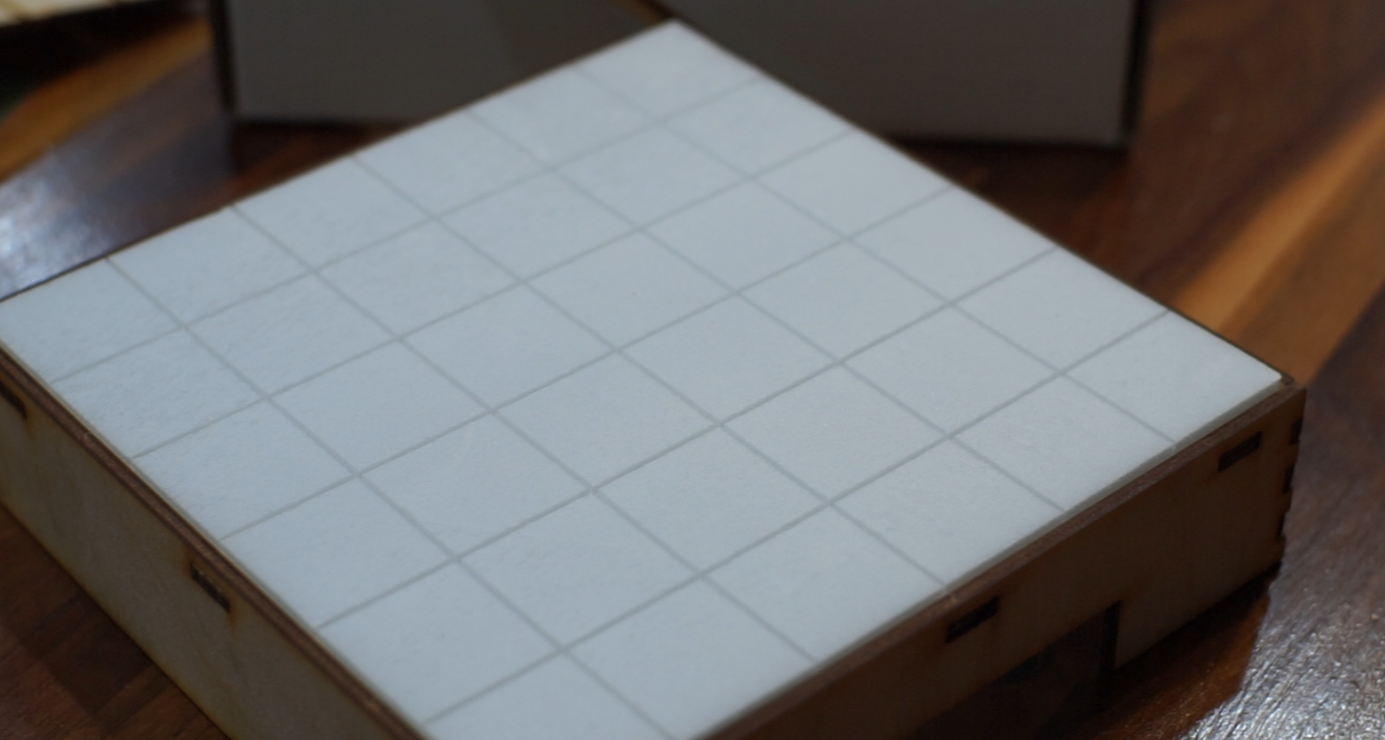
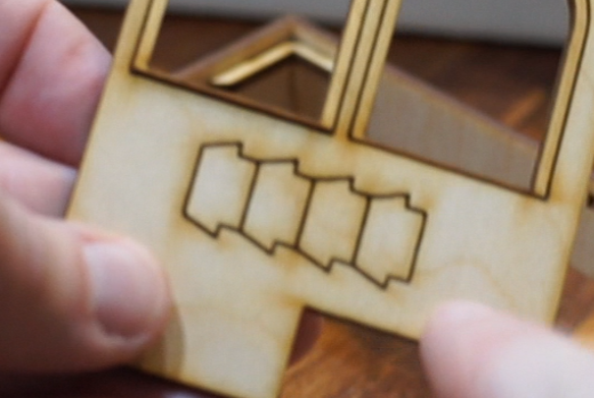
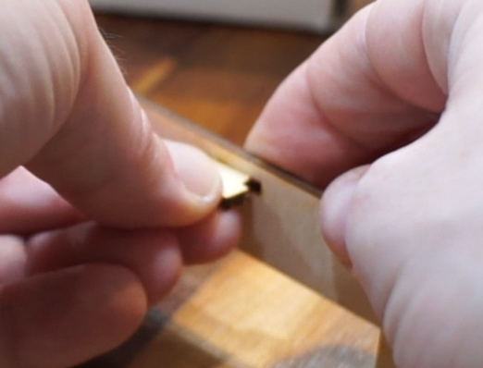
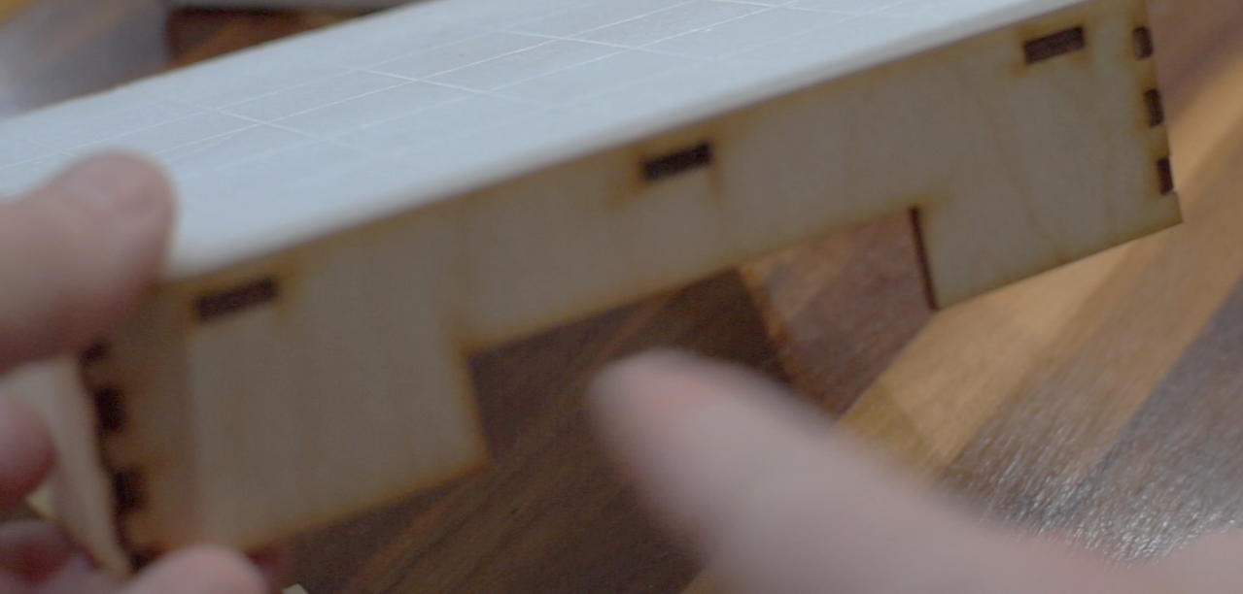
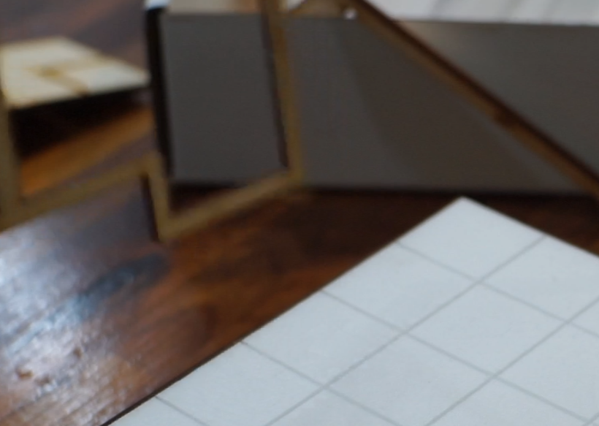
Grab 4 mid-section supports and install.
Place one of the 2 foam floors on top.
One of the sides has an electrical cutout on it’s base. Line this up with the wall section that has a cutout.

Slide 7
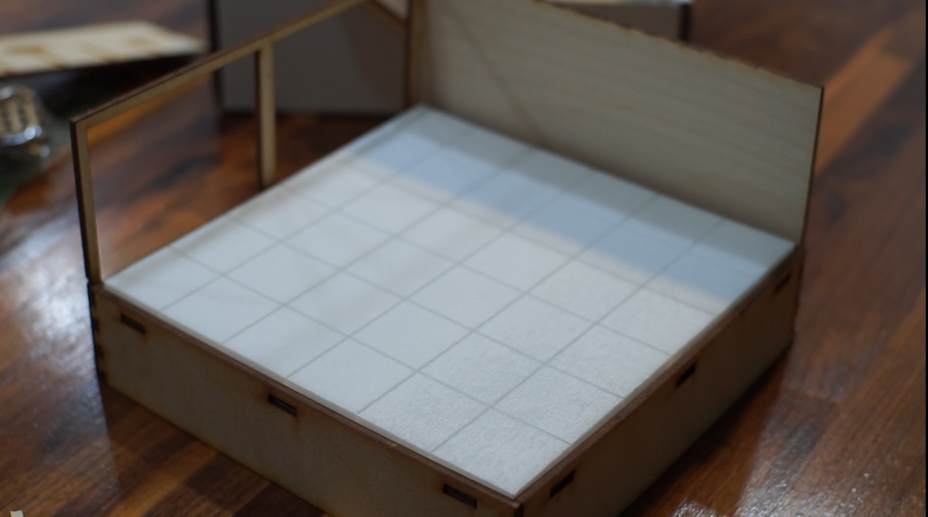
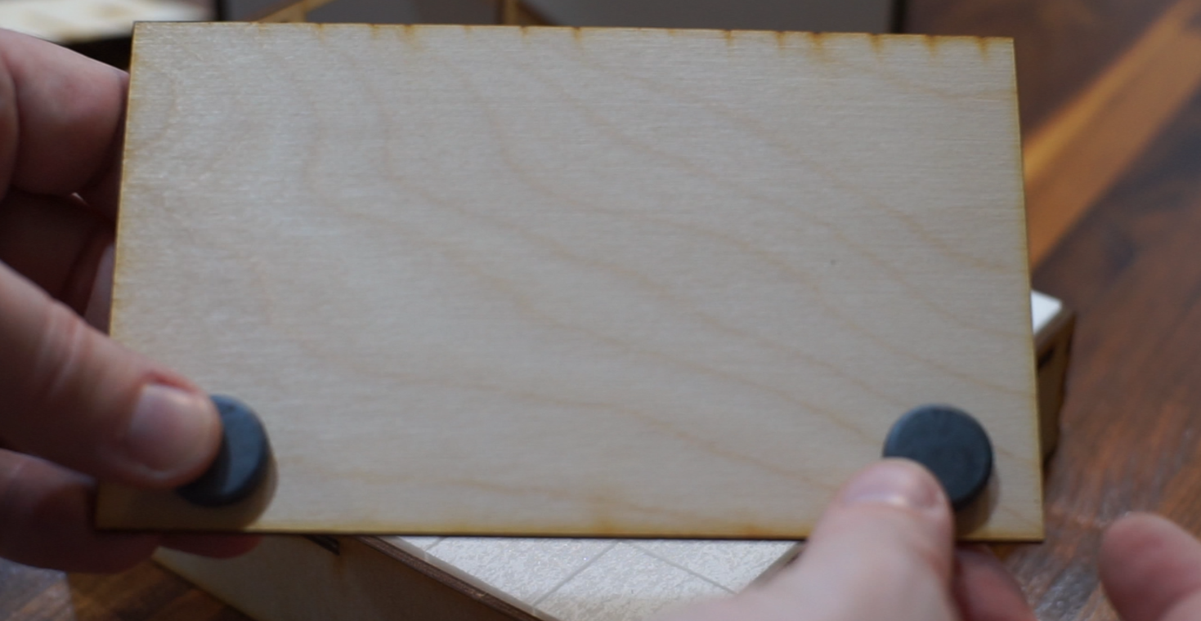
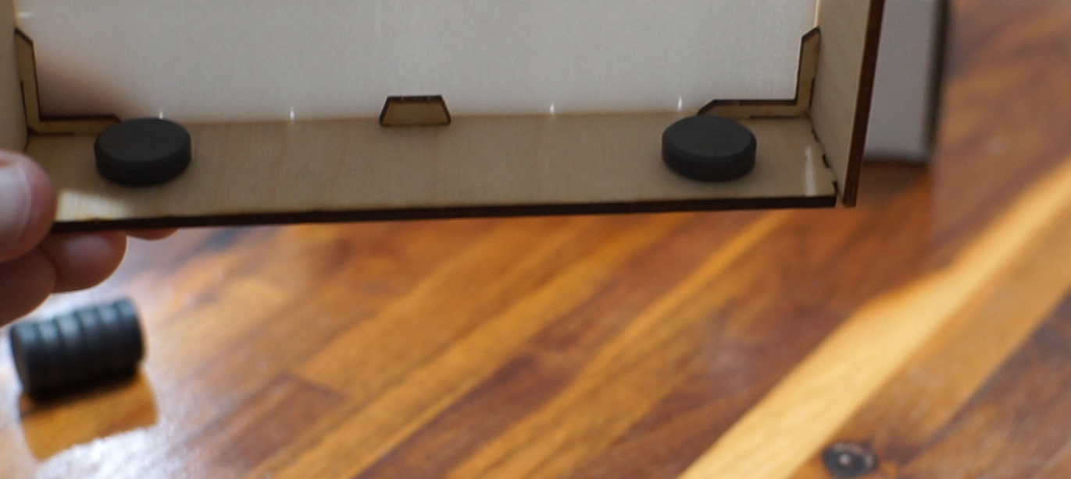
Place both wall sections in place. Add foam face if required, then place magnets behind.
Once outside wall magnets are glues, align magnets on inside of base to hold in place.

Slide 8
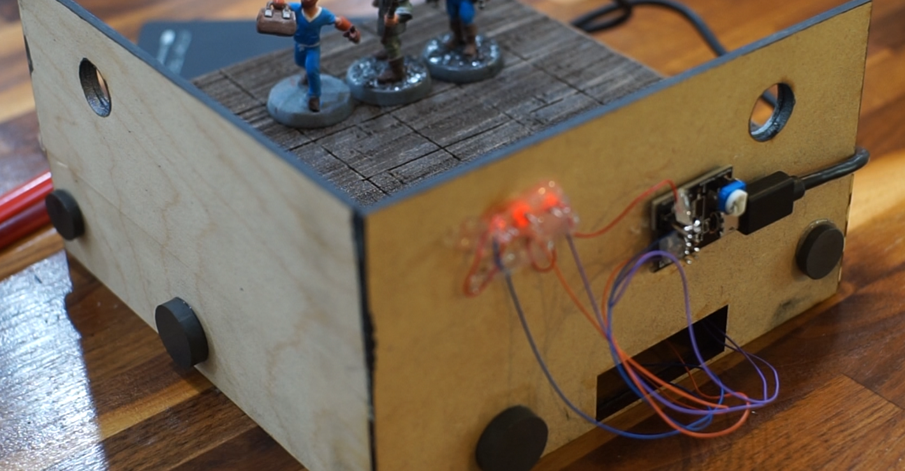
LED’s
USB Power Bank or CR2032
Conwy Castle Board
Access to reed switches below the floor

